Slide 1
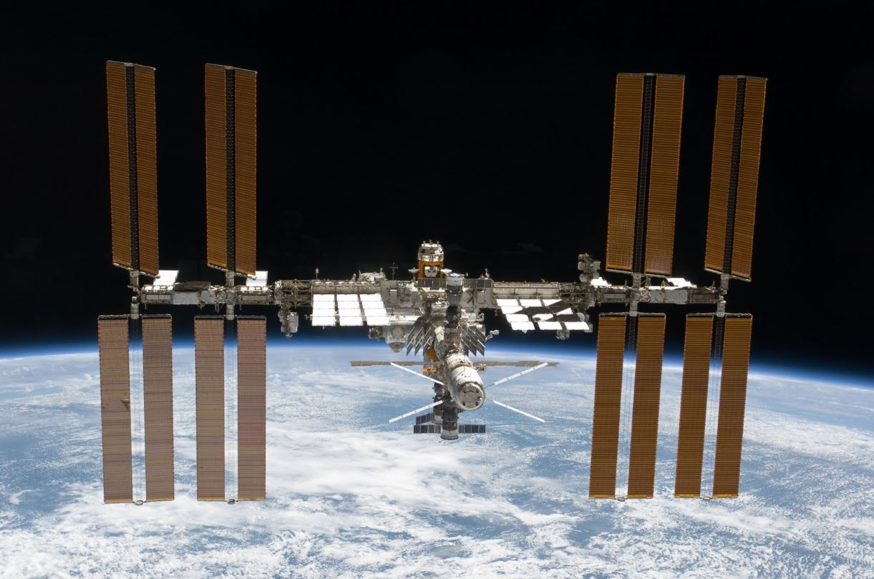
Satellite communications and the environment of space
Images: NASA

Slide 2
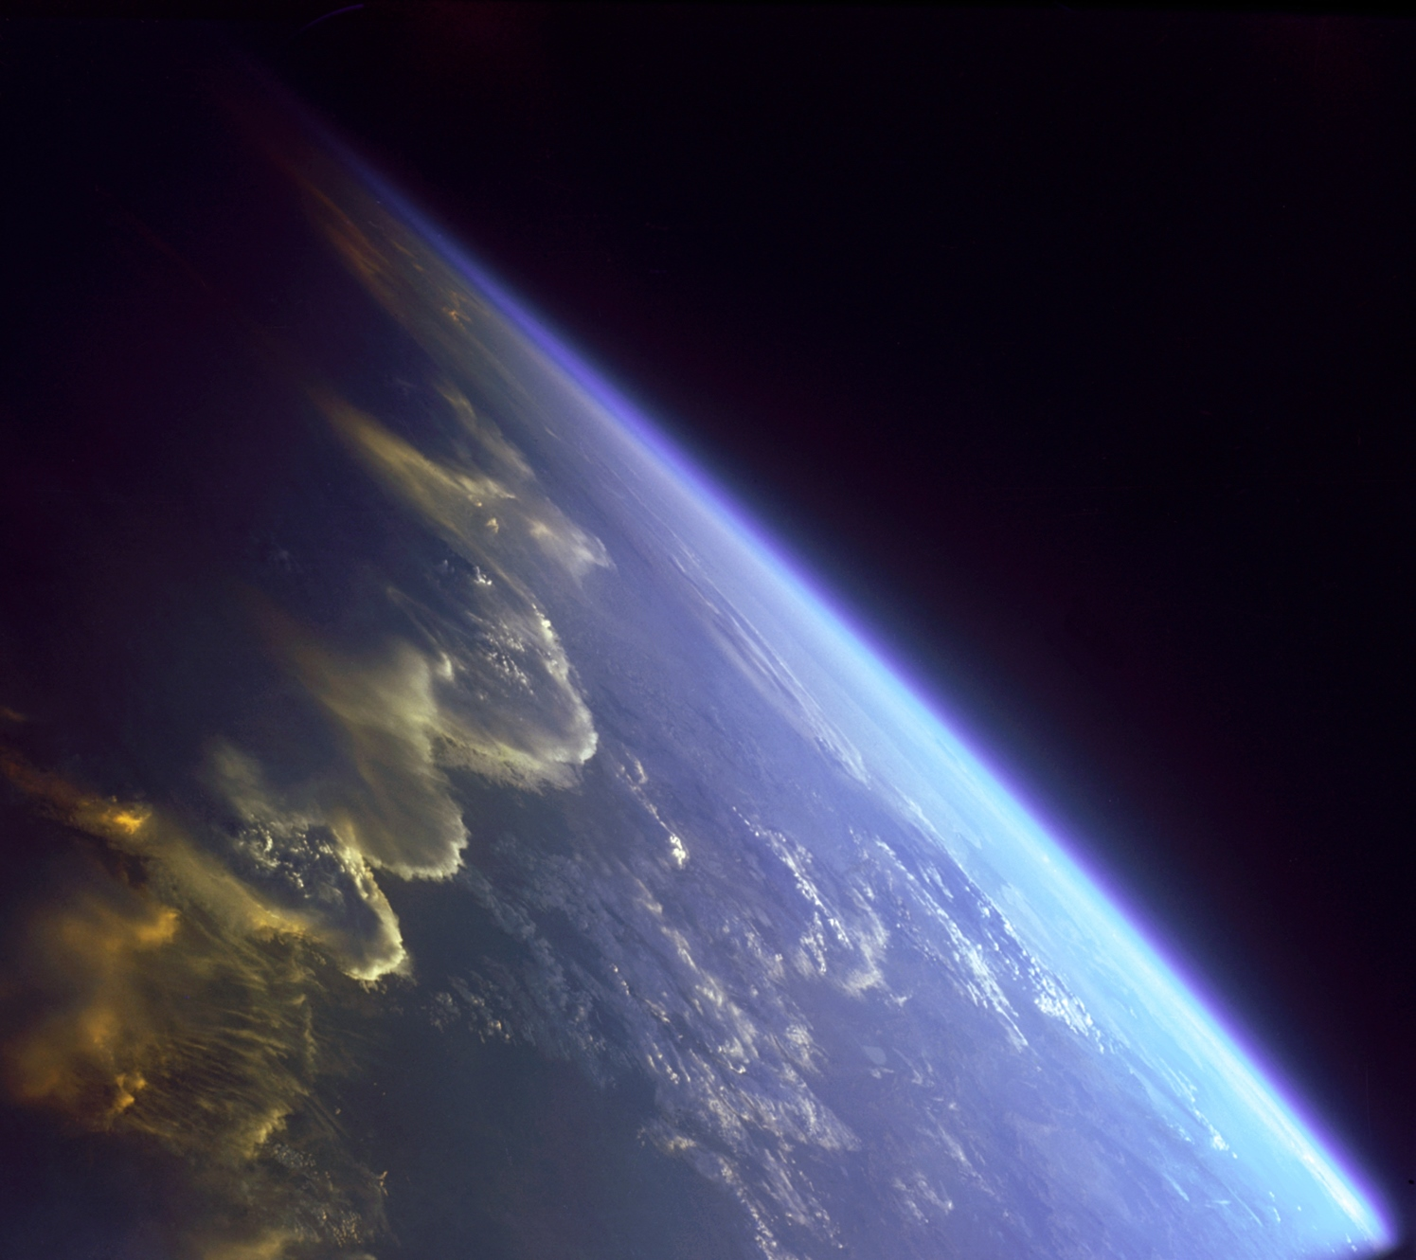
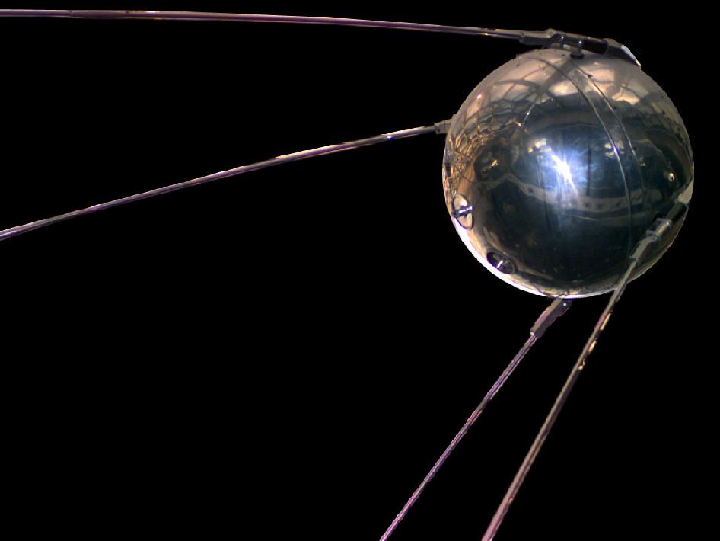
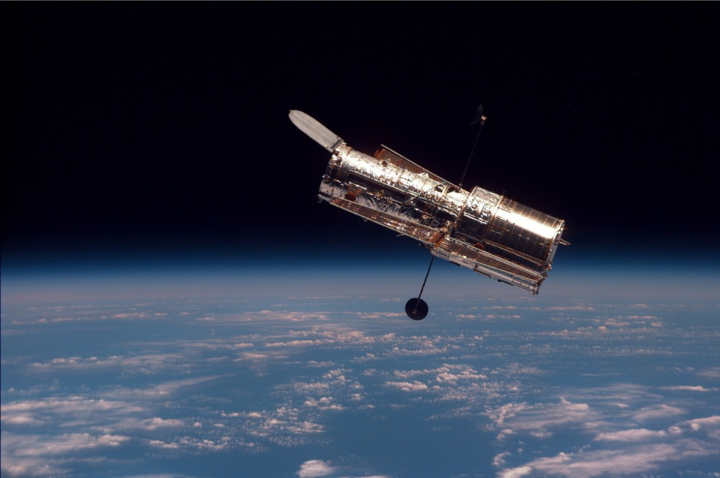
Can you name these satellites ?

Slide 3
Sputnik
The first man made satellite
Launched in 1957 by The USSR
Mass 84kg, diameter 53cm
The Hubble Space Telescope
The International Space Station
Notes:
The international Space Station is over 100 metres long and has a crew of 3 to 7 astronauts.
It can be seen with the naked eye just before dawn or just after sunset flying across the sky. Sunlight reflected from the ISS and its large solar panels makes it brighter than any of the stars.
Sputnik started the ‘Space Race’ between The USSR and The United States. It also accelerated the cold war because the ability to put a satellite into orbit also gave the ability to launch nuclear weapons between continents without using aircraft.

Slide 4
Now there are hundreds of satellites in orbit around the Earth
while others are exploring the solar system.
Notes:
As of Jan2014 there are over 39,000 catalogued objects orbiting the Earth. Only a minority are functioning satellites.
Other items include spent parts of rocket bodies. Satellites that have failed or been replaced, and thousands of pieces of space debris from objects that have broken up or exploded.

Slide 5
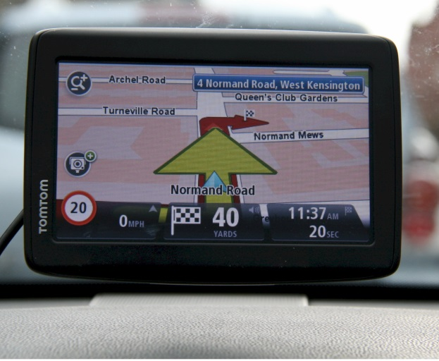
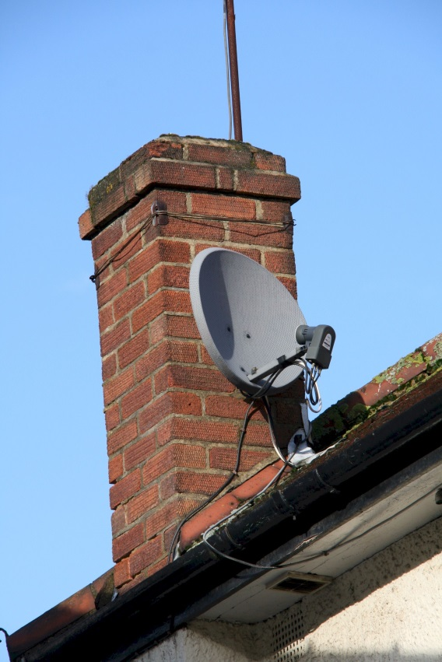
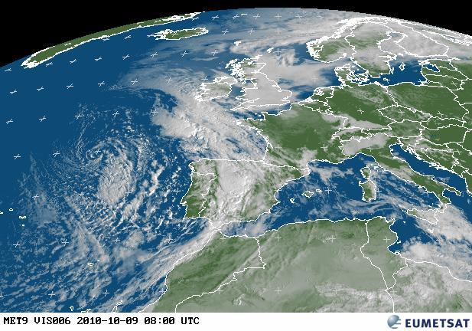
Now there are hundreds of satellites in orbit around the Earth
while others are exploring the solar system.
Satellites are used for some familiar services.
TV broadcasting
Satellite Navigation
Weather forecasting
Notes:
Some other uses include. Earth observation.
e.g. Locating water in drought areas.
Disaster monitoring. – Tsunami / Fires / earthquakes / storm damage
Monitoring for evidence of global warming at the polar caps. Deforestation in the Amazon rain forest.
There are satellites orbiting Mars Venus and Saturn while some monitor the Sun and others are chasing comets.

Slide 6
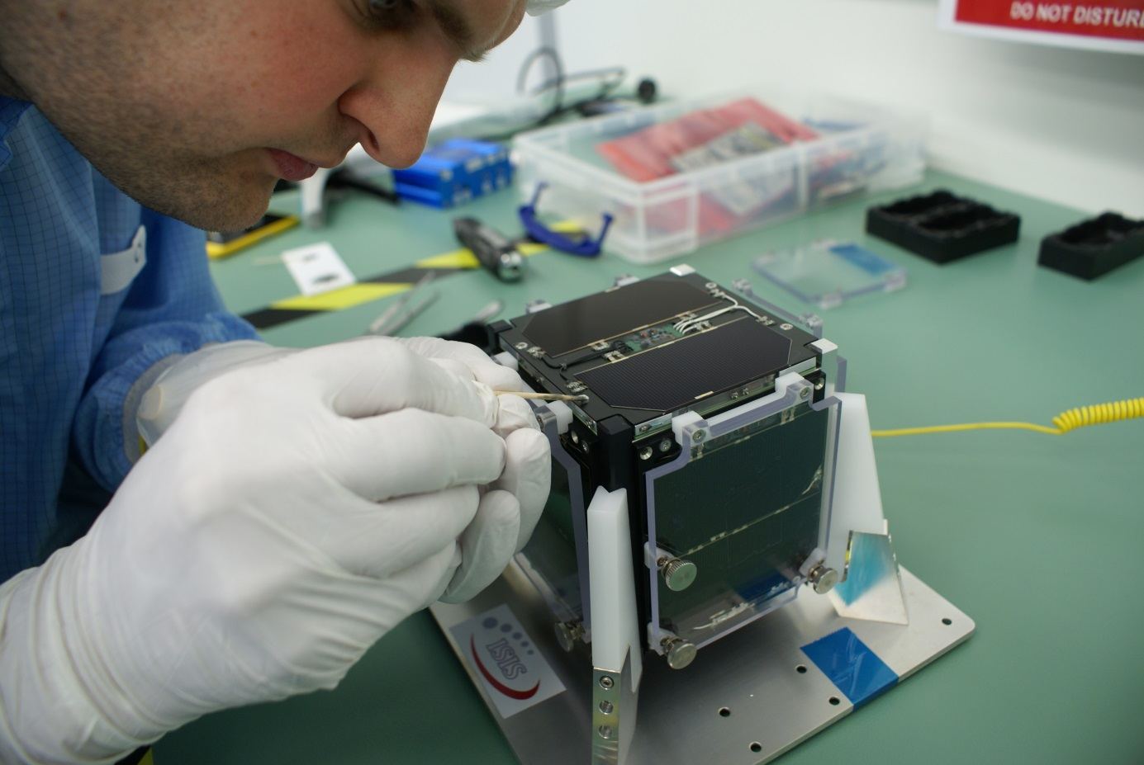
Satellites operate above the Earth’s atmosphere. (Vacuum) and need to travel at high velocity to stay in orbit
All of the data they collect or relay is sent back to Earth by radio communication.
But…..Not all satellites are large
Notes:
This is the FUNcube satellite having glue applied before being sent to Russia for launch.
It is powered by solar cells when it is illuminated by the Sun and by batteries when it is in the shadow of the Earth. (Eclipse)

Slide 7
Satellites operate above the Earth’s atmosphere. (Vacuum) and need to travel at high velocity to stay in orbit
All of the data they collect or relay is sent back to Earth by radio communication.
But…..Not all satellites are large
Name: FUNcube
Mass : 937g
Power: Solar panels and batteries
Size: 10 x 10 x 10cm
Orbit: Polar
Altitude - 630km
Notes:
Known as a ‘CubeSat’, this type of satellite is popular for testing new technologies and as projects for University students studying Space Engineering.
Although CubeSats are small, the cost of launching a mass of 1kg into space is around 50,000 Pounds or Euros.

Slide 8
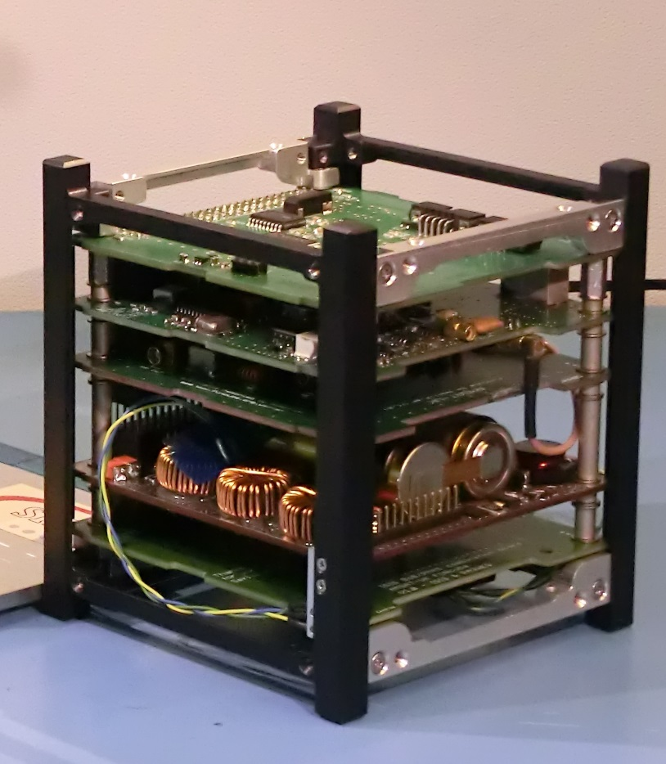
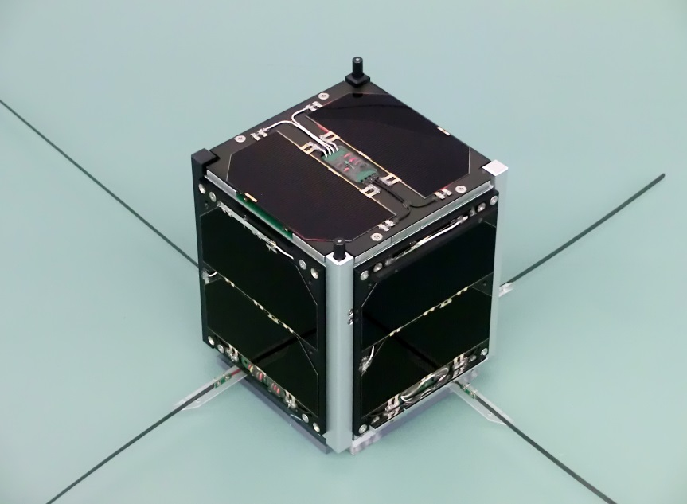

The FUNcube Satellite
With solar panels and communication antennas
The sound of Morse code. Around 10 ‘bits’ of data per second
Inside the satellite, you can see some of the electronics and the battery that provides power in eclipse
The sound of FUNcube’s signal from space. Sending data at 1200 bits per second
Notes:
The battery used, was originally intended for use in laptop computers.
TELEMETRY. FUNcube sends digital signals back to Earth which include information about its own health. This data is collected from dozens of sensors in the satellite which monitor Temperatures / Voltages / Current / and Power. Each ‘frame’ of data is sent every 5 seconds and it takes 2 minutes to send all of the data stored in the satellites memory.
Audio samples.
Morse code: Is an early form of ‘digital’ communication. Each character (letter number or symbol) must be decoded by the person listening. This requires training and the maximum speed is limited to about 100 – 200 characters per minute. - The message recorded says “ SOS SOS TITANIC”
FUNcube data: In the audio sample, the data is not the beep every 5 seconds, the data is contained in the sound between the beeps. Unlike Morse code, the human ear cannot hear individual bits of data. The 1200 bits sent every second by FUNcube is received on the ground then fed into a computer sound card. The computer decodes the data and displays it graphically.
Launch Video. November 21st 2013. Launched from an underground silo in southern Russia, the ‘cold war’ Intercontinental ballistic missile carried 32 satellites to an orbit 630km above the Earth. If you look carefully, you can see the rocket is pushed out of the silo, then its engines start as it hangs in mid-air. Time from ground to orbit was 12 minutes.

Slide 9
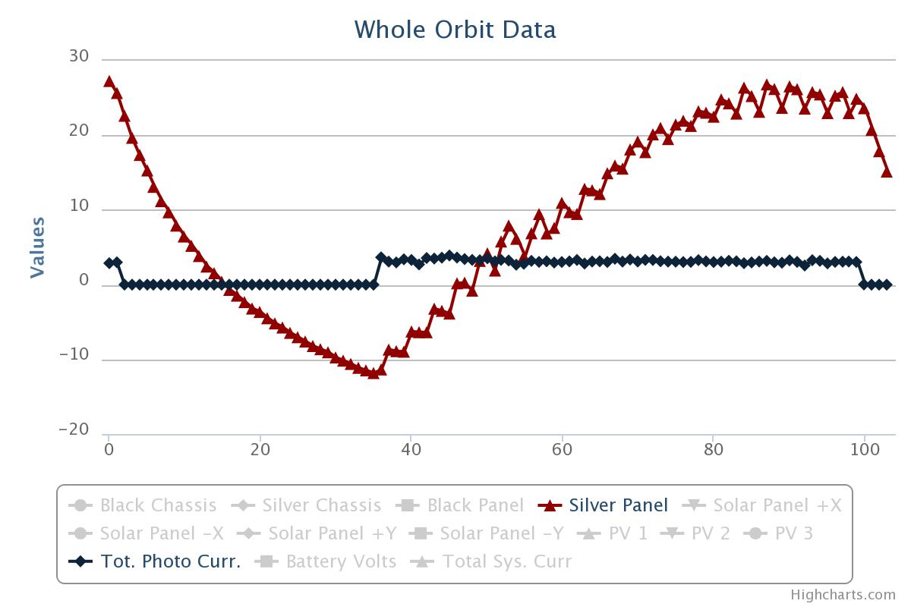
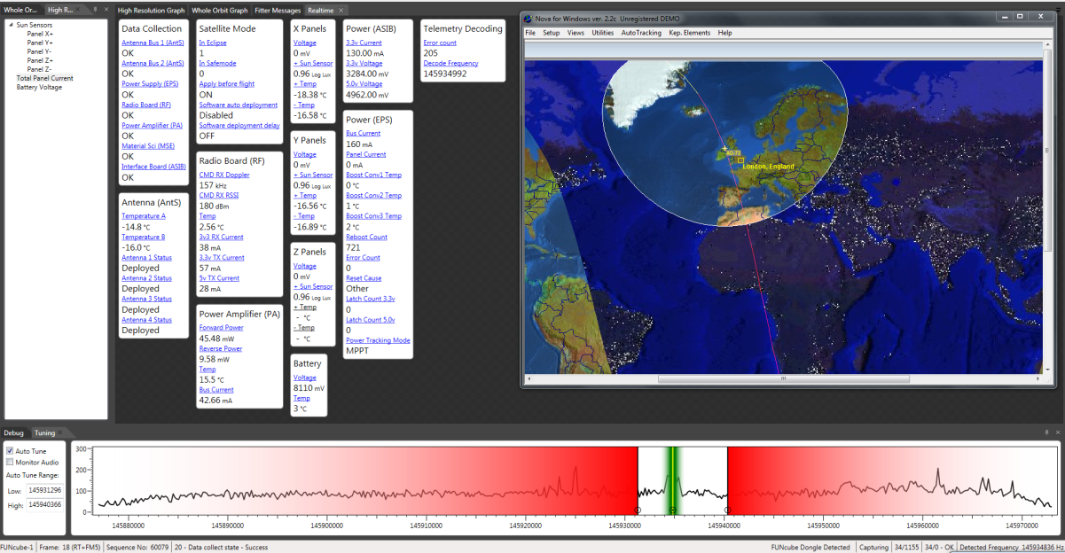
Your task today is to investigate FUNcube and the environment of space by using graphs produced from the satellite’s telemetry.
Ex1. Use the graphs provided to find the time taken for FUNcube to complete one orbit of the Earth. Then use this to calculate the velocity of the satellite
Ex2. Find the maximum and minimum temperatures the satellite experiences in one orbit. Compare your results with the range of temperatures during a day here on Earth
Ex3. FUNcube uses its solar panels to produce electrical energy from sunlight. Use the graphs to investigate how much power the satellite produces in sunlight and how the battery is used in eclipse.
Notes:
The example graph on the left shows time on the X axis ( 105 minutes) against temperature (red) in degrees. Also shown in black is solar panel current. – Value of zero = satellite in eclipse.
The right image is from the computer software that can be used to receive and decode the data as the satellite passes overhead.
FAQ 1) What is the circle centred on the UK? – This shows the ‘footprint’ of the satellite which, in this image. is over N Ireland. The edge of the circle is the horizon as seen from orbit. Apx 2800km radius.
2) How long will it be in space? – At 630km FUNcube will be in space for about 25 years before it slowly descends into the atmosphere. From an orbit at 300km it would stay in space for about 6 months
3) Are there jobs in the space industry? Yes, for example the new European ‘Sat Nav’ satellites, called Galileo, are being assembled in Guildford Surrey

