Slide 1
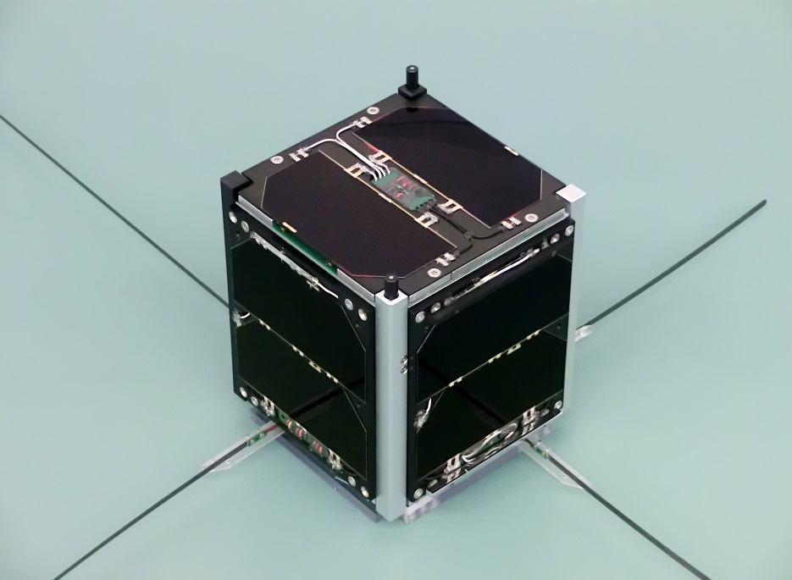
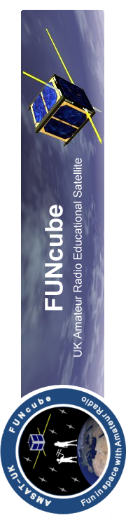
FUNcube-1
Using satellites in schools
and colleges
Notes:
A picture of the actual spacecraft during testing before launch

Slide 2
Introduction to FUNcube-1

Slide 3
What is FUNcube-1
FUNcube-1 is a 1U CubeSat that was designed, built and financed ENTIRELY by volunteers and supporters of AMSAT-UK and AMSAT-NL
“1U” means that it is one unit in size/weight – that is, its dimensions are 10x10x10 cm in size and a launch mass of just 988 grams
AMSAT-UK and AMSAT-NL are two of many AMSAT organisations worldwide comprising radio amateurs who have a special passion for space based communications.
After four years of work was finally launched 21st Nov 2013 from Russia
Notes:
The location of the launch day monitoring station

Slide 4
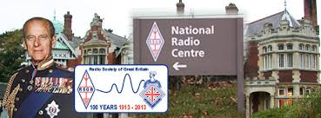
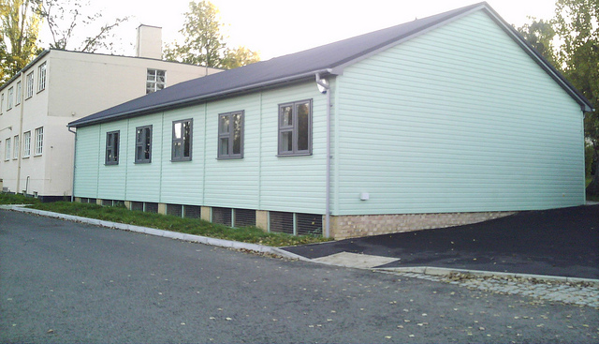
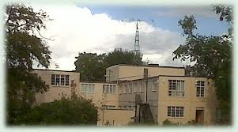
FUNcube-1 Launch Day monitoring station- Bletchley Park

Slide 5
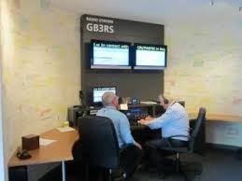
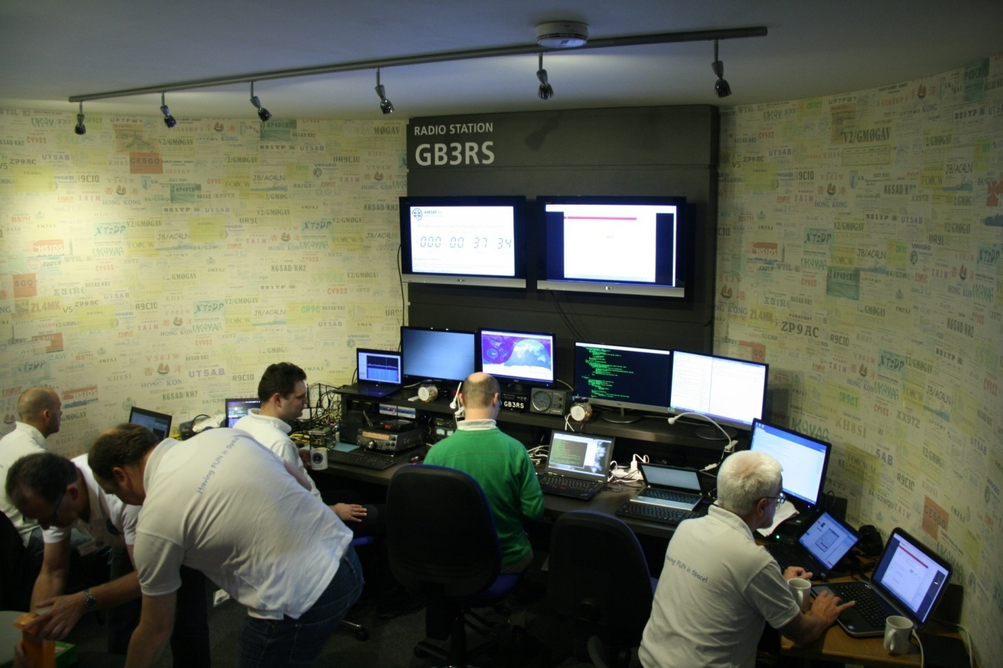
FUNcube-1 Launch Day Monitoring station- Bletchley Park
Notes:
On the left the room as it normally is – on the right the day prior to launch day after we had set up rather more computers and other equipment

Slide 6
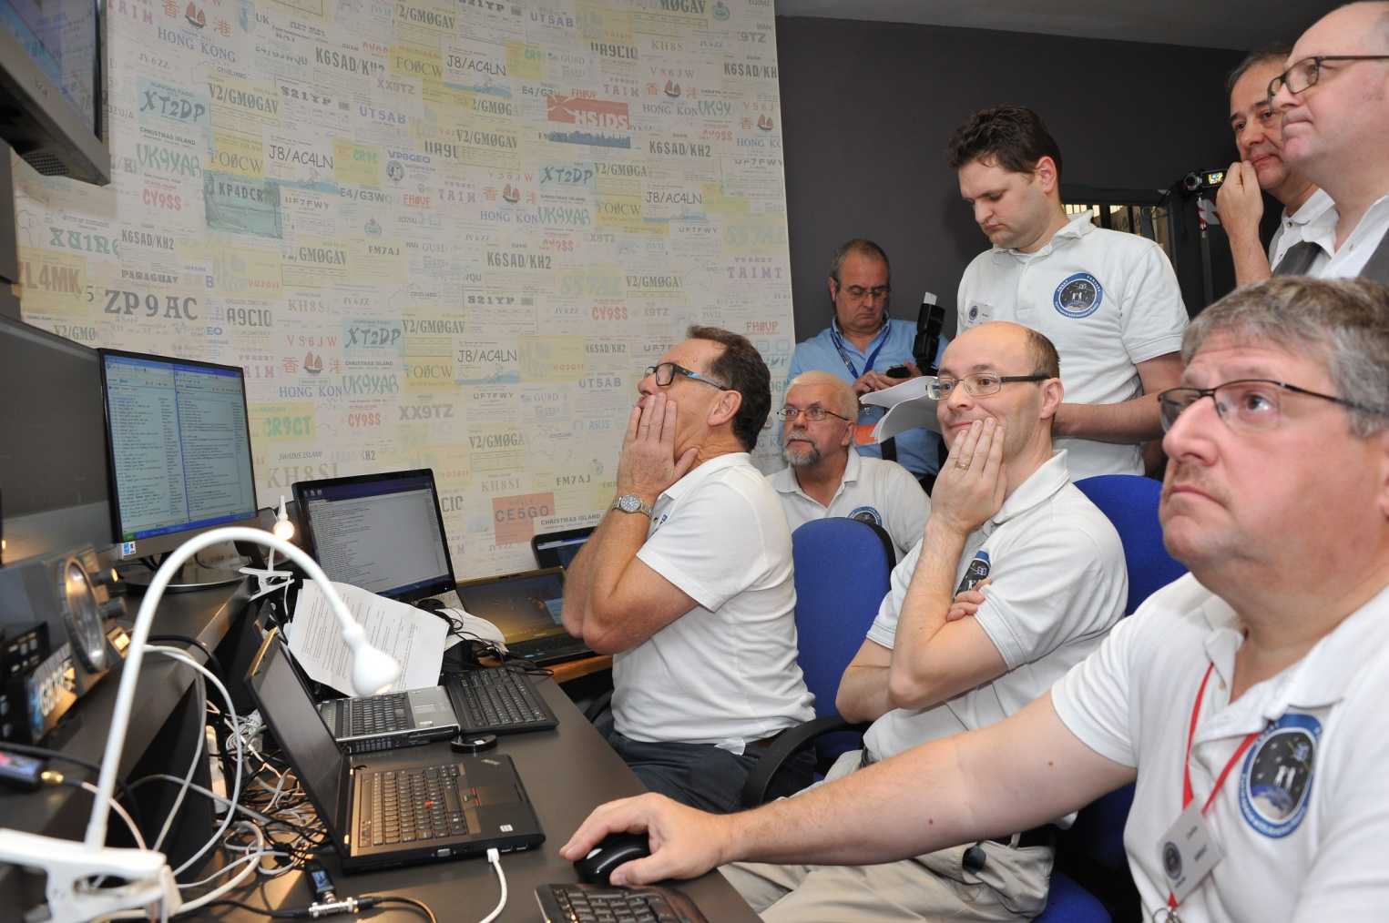
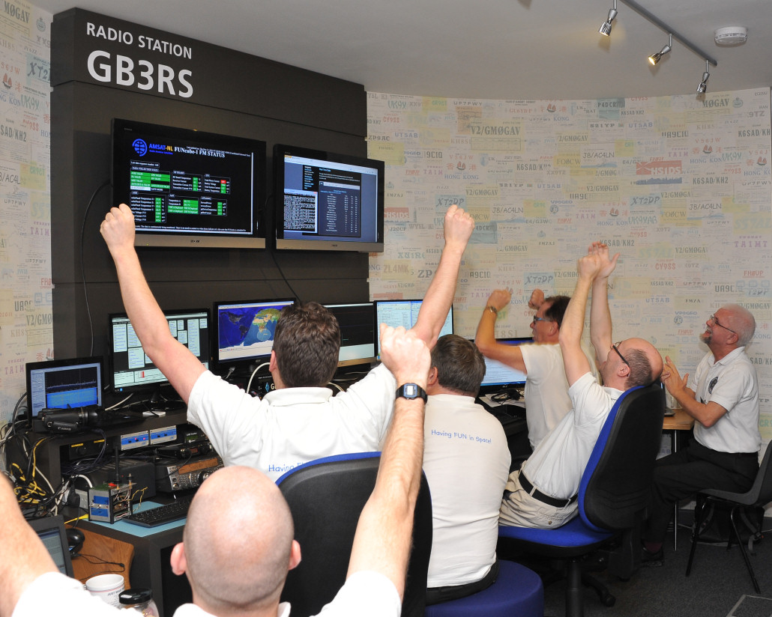
Notes:
Before we had seen the first signals from space and then just after we received the first data via a station in South Africa

Slide 7
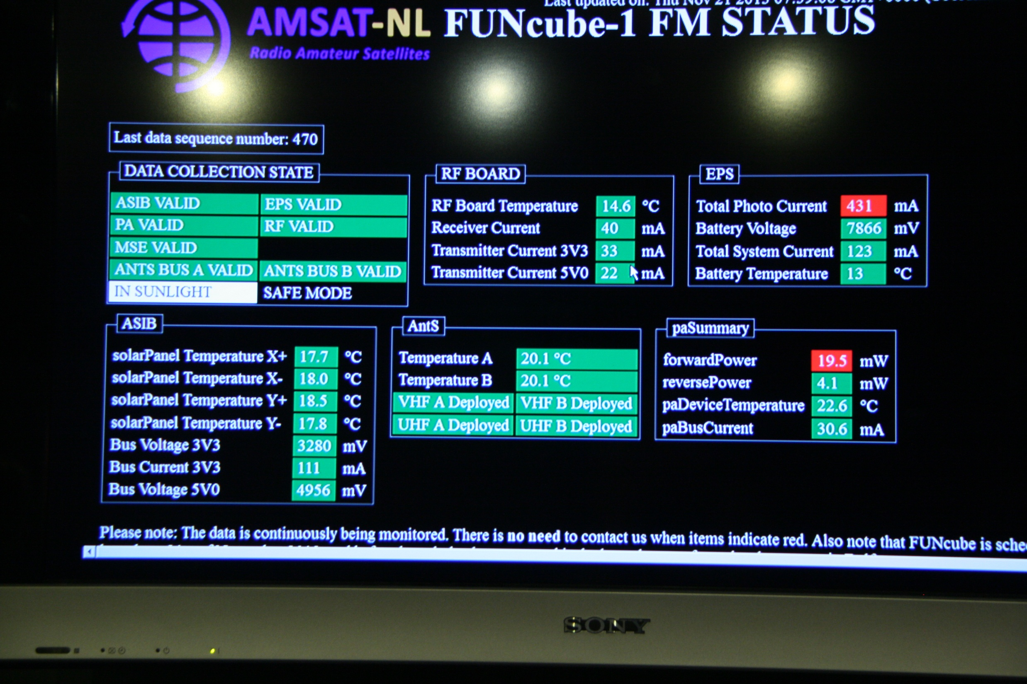
The FUNcube Project
22/06/10
7
Notes:
7
The first data form FUNcube-1 just after deployment

Slide 8

FUNcube-1
PRIMARY MISSION
During the sunlit part of its orbit
(65 mins), FUNcube-1 operates in EDUCATIONAL mode
  High power (300mW) telemetry
  Generally three passes every morning wherever you are on earth
SECONDARY MISSION
During eclipse (32mins), FUNcube-1 operates in TRANSPONDER mode.
  Used by radio amateurs to communicate over long distances via the satellite.
  Telemetry still transmitted but at low power (30mW)
  Generally three passes every evening wherever you are on earth

Slide 9
FUNcube-1
FUNcube-1 orbits the earth in a “Sun synchronous” low earth orbit that has a period of approx 97 minutes.
More than 50 telemetry channels are transmitted to earth.
Real Time, Hi-Res, Whole Orbit Data & Greetings Messages
Radio Amateurs and interested individuals, worldwide, can receive the telemetry directly via the “Dashboard” and submit it to the “Central Data Warehouse” for storage and distribution

Slide 10
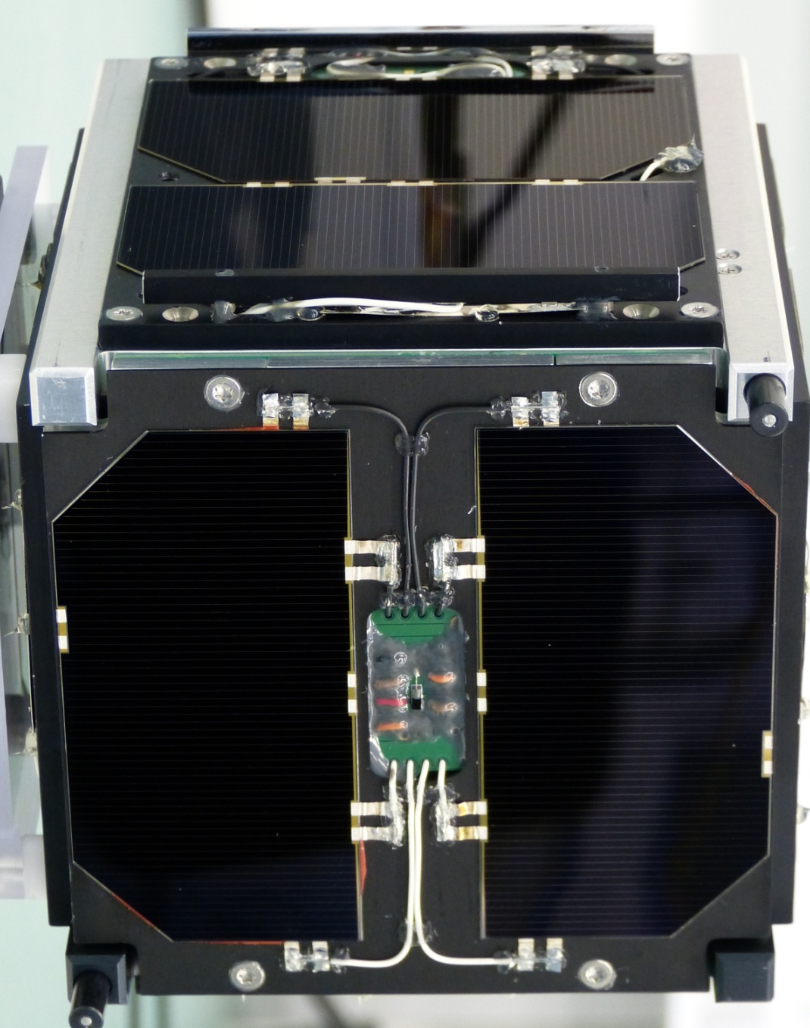
FUNcube-1
FUNcube-1 has six surfaces :-
    All of the faces have solar panels
    One face has black & silver strips
The voltages and currents from the solar panels, and the temperatures of the these strips are recorded every minute.
This forms the Materials Science Experiment, or “MSE” part of the FUNcube mission.
Notes:
The top face has the black and silver MSE strips

Slide 11
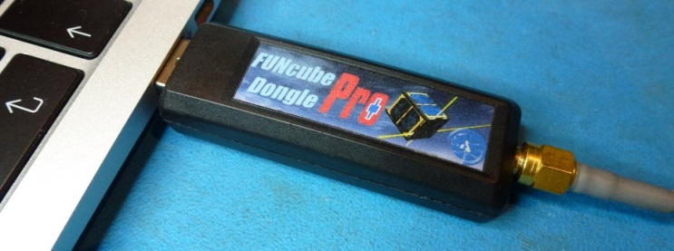

The Ground Segment
The antenna choices:
Temporary– omni-directional
Temporary – hand held yagi
Permanent – Turnstile or similar omni
The Receiver choices:
SDR – FUNcube Dongle
Conventional amateur VHF radio
A Windows laptop or PC
Notes:
The signals has a very distinctive “beep” every 5 seconds so it is easy to recognise by ear

Slide 12
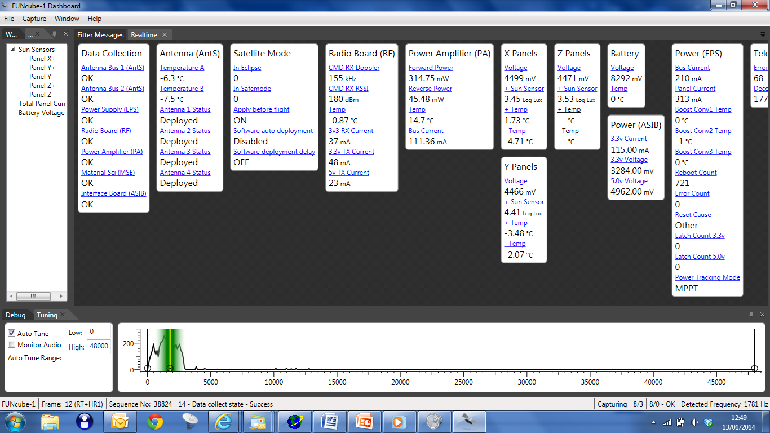
The Dashboard
The Telemetry Dashboard is a Windows based program that receives, decodes and displays the telemetry
Notes:
The dashboard with the spectrum display at the bottom and some realtime telemetry displayed

Slide 13
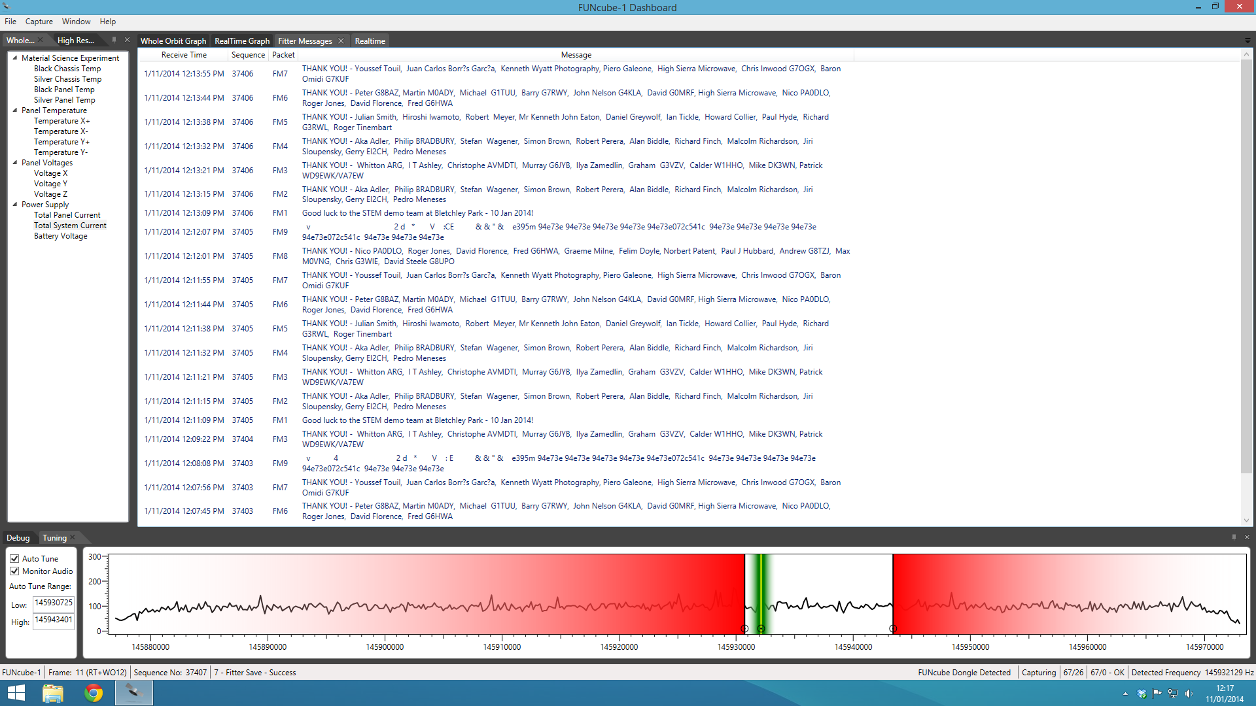
The Dashboard
Notes:
Nine Fitter messages

Slide 14
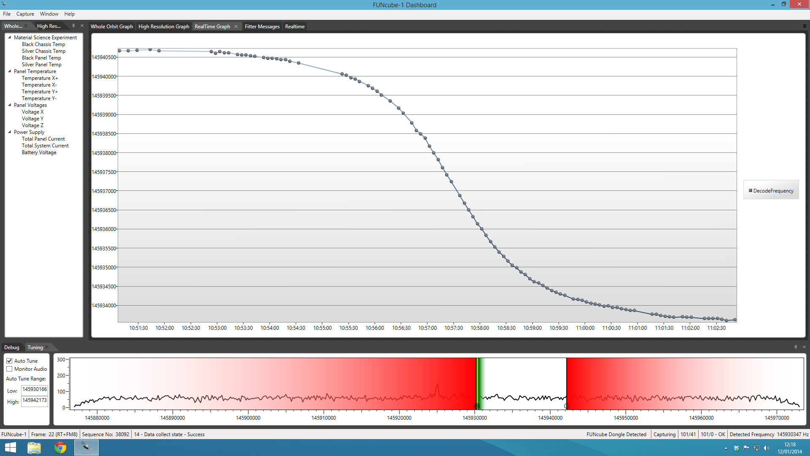
The Dashboard
Notes:
A doppler curve from space

Slide 15
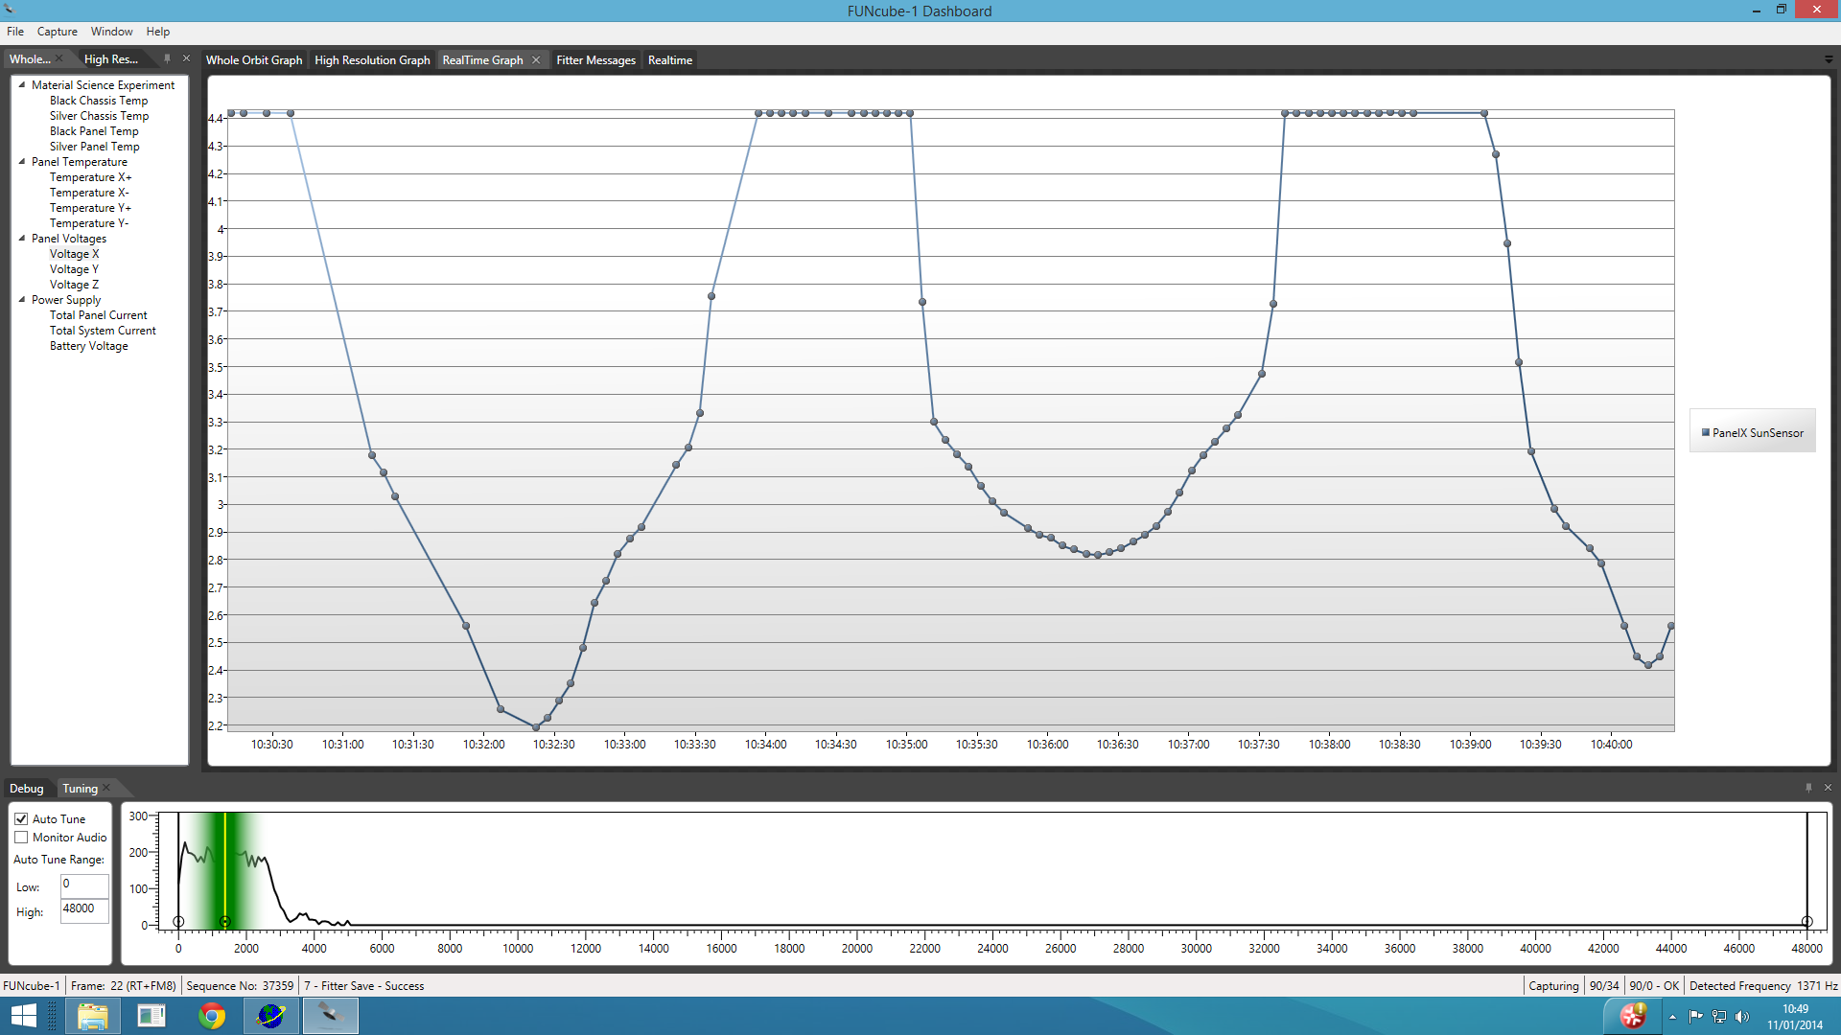
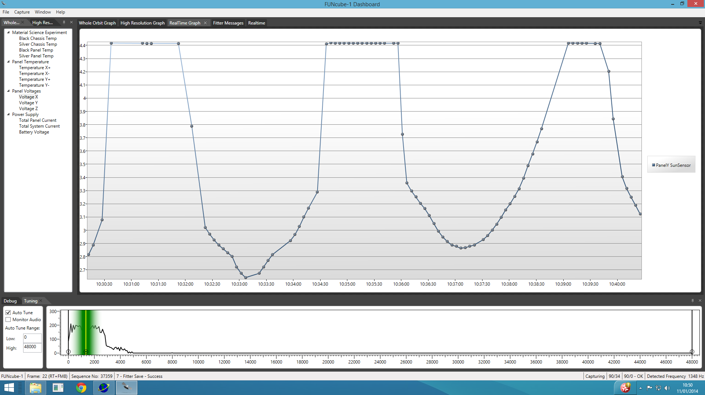
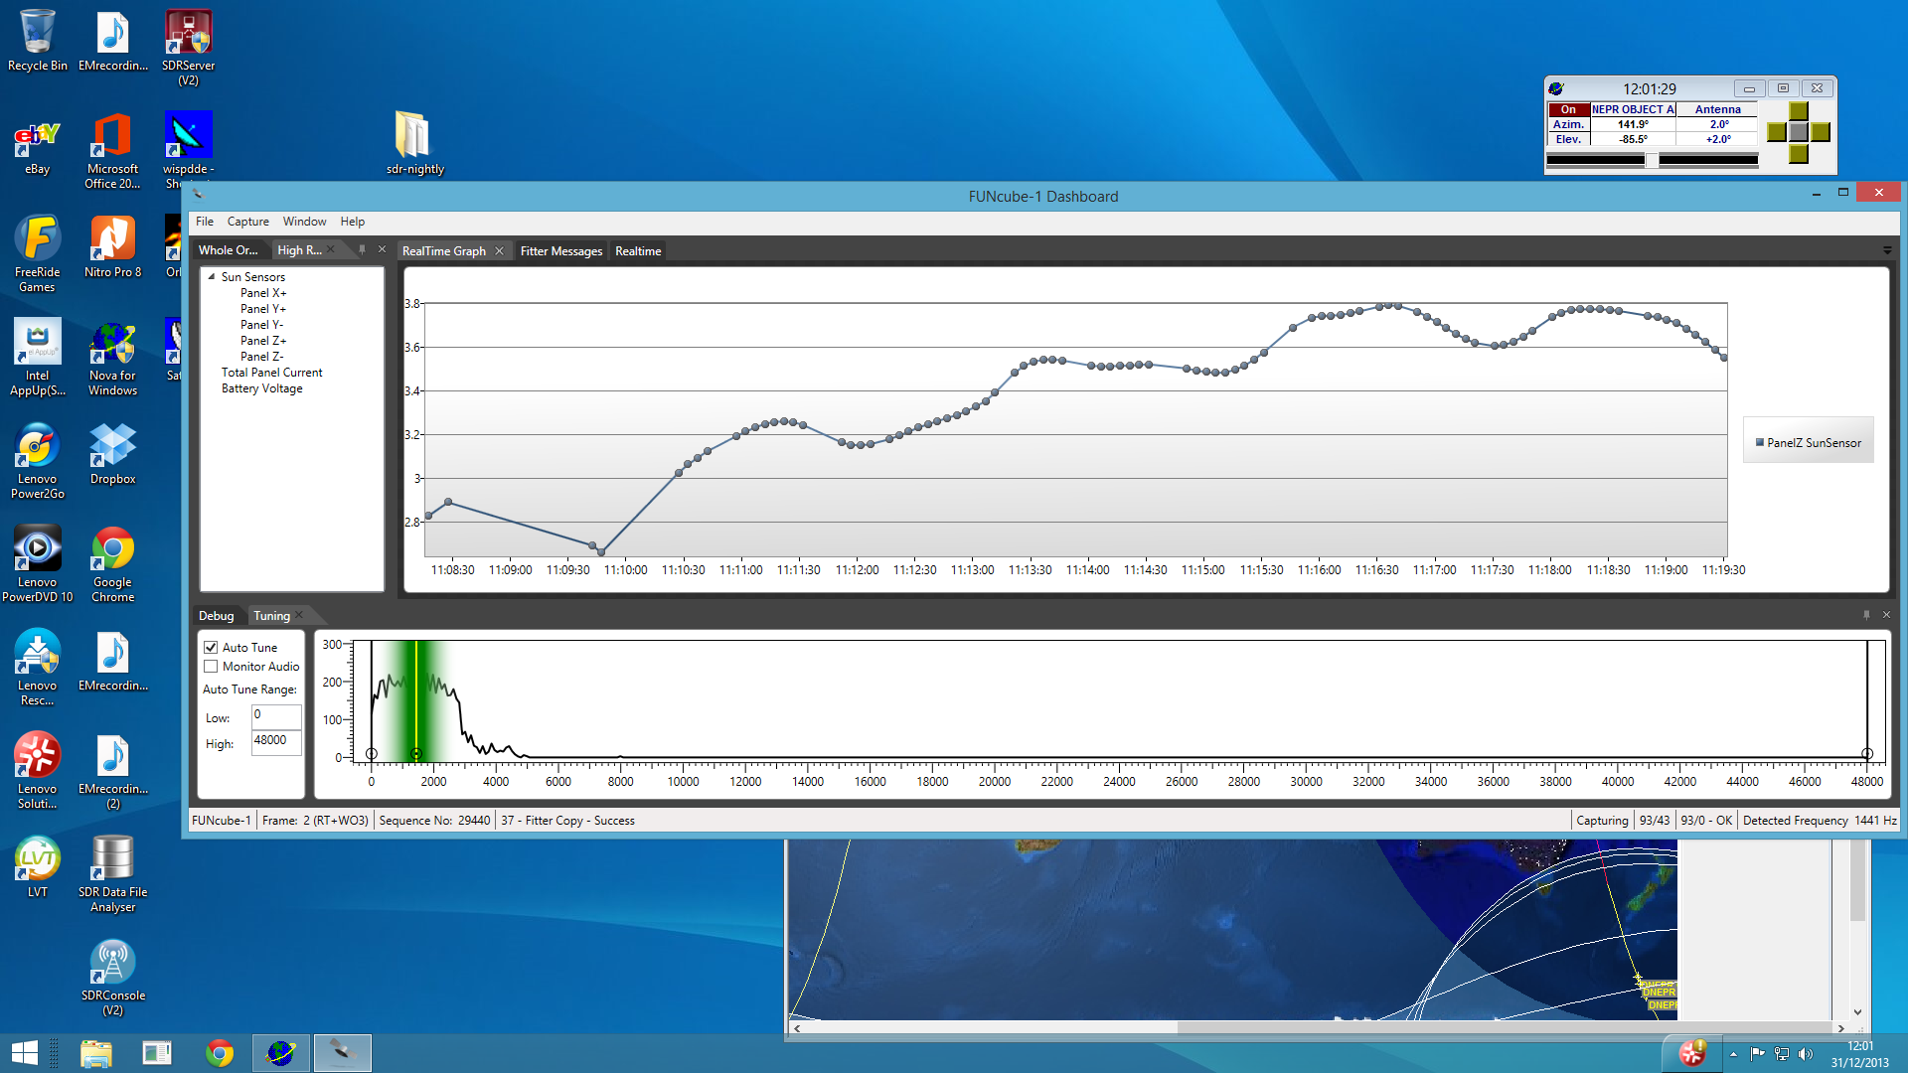
The Dashboard
Notes:
Sun sensors on three faces – showing the spin or “rotation” rate around the Z axis

Slide 16
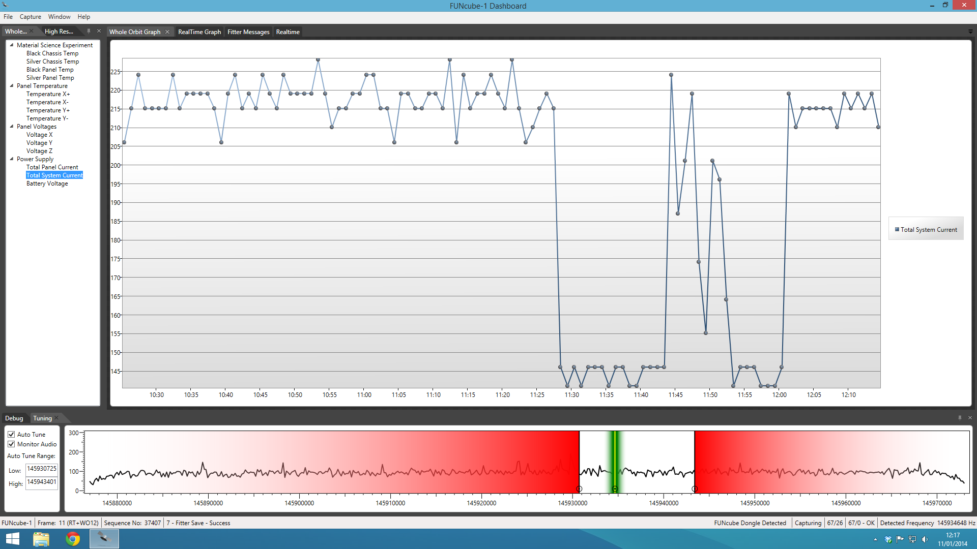
The Dashboard
Notes:
Power consumption – 220mA when in the sun and only 140mA when in eclipse until amateurs start using the transponder!

Slide 17
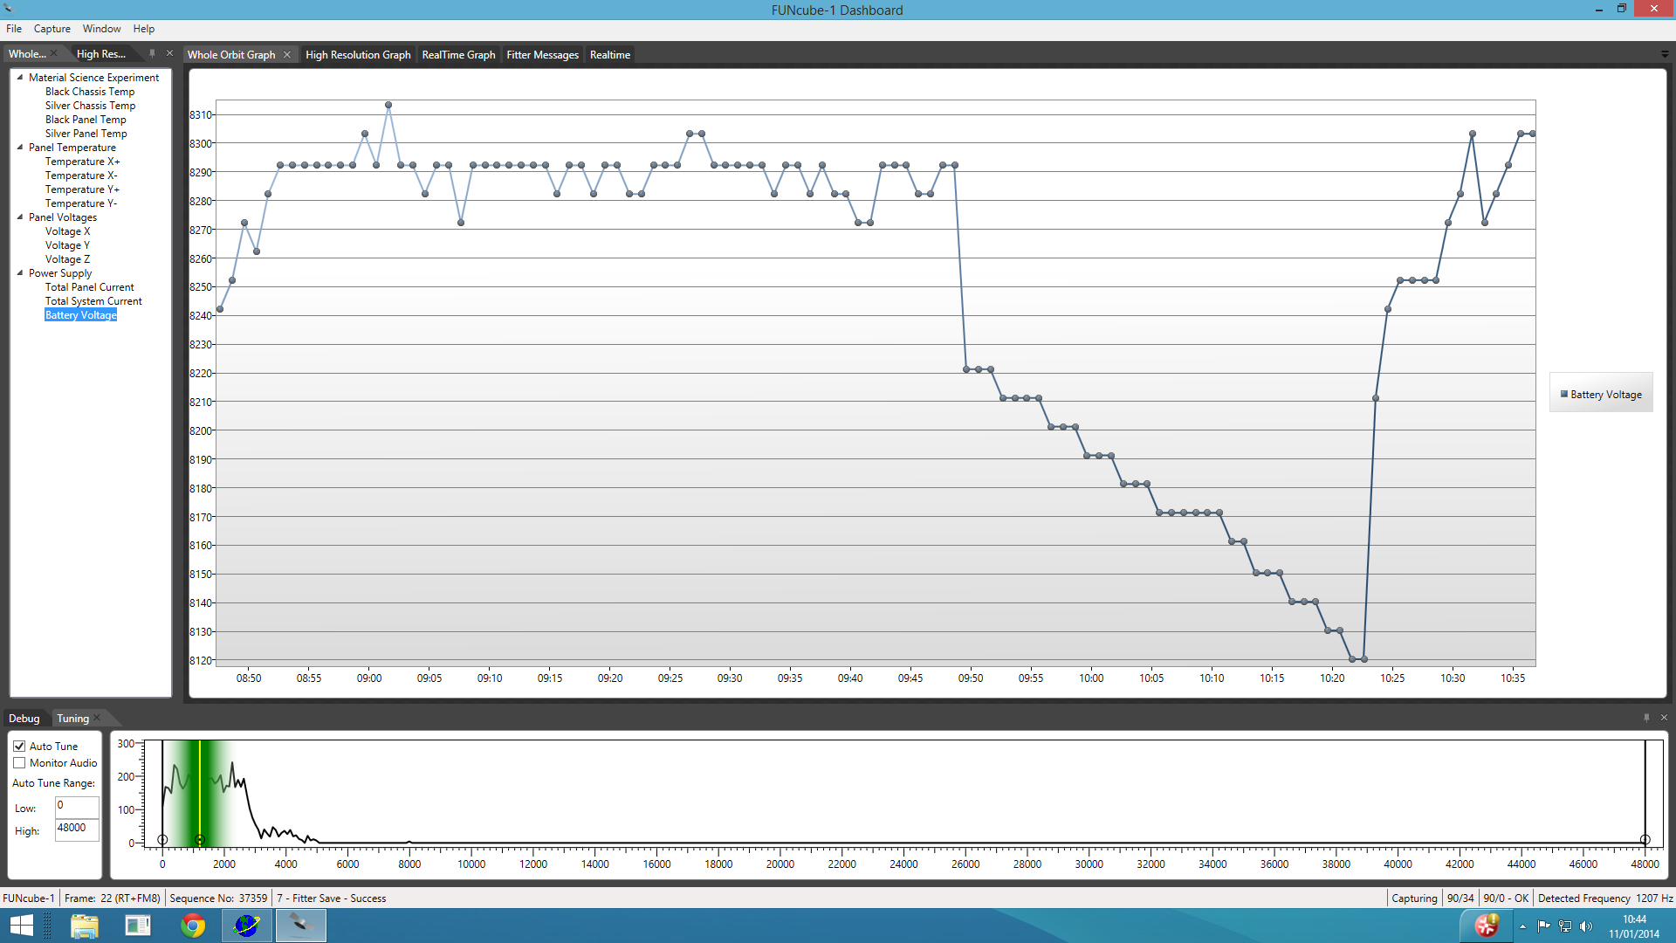
The Dashboard
Notes:
Battery volts – again Whole orbit Data showing sunlit and eclipse values...we are only discharging the battery by about 5% each eclipse and recharging within 15 mins of re-entering sunlight

Slide 18
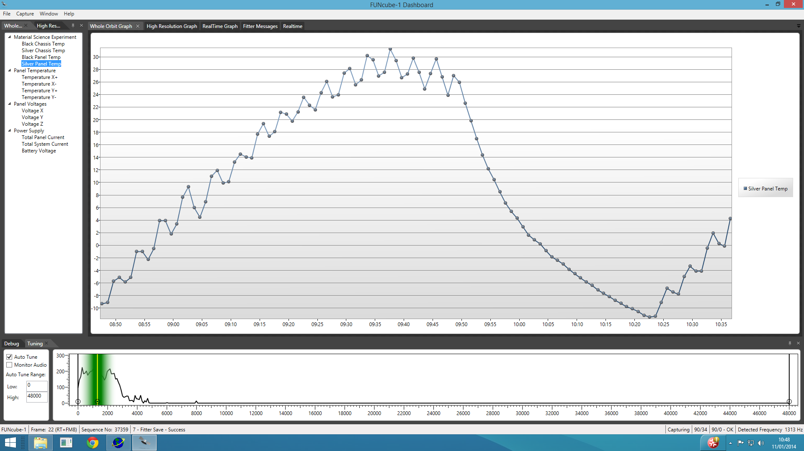
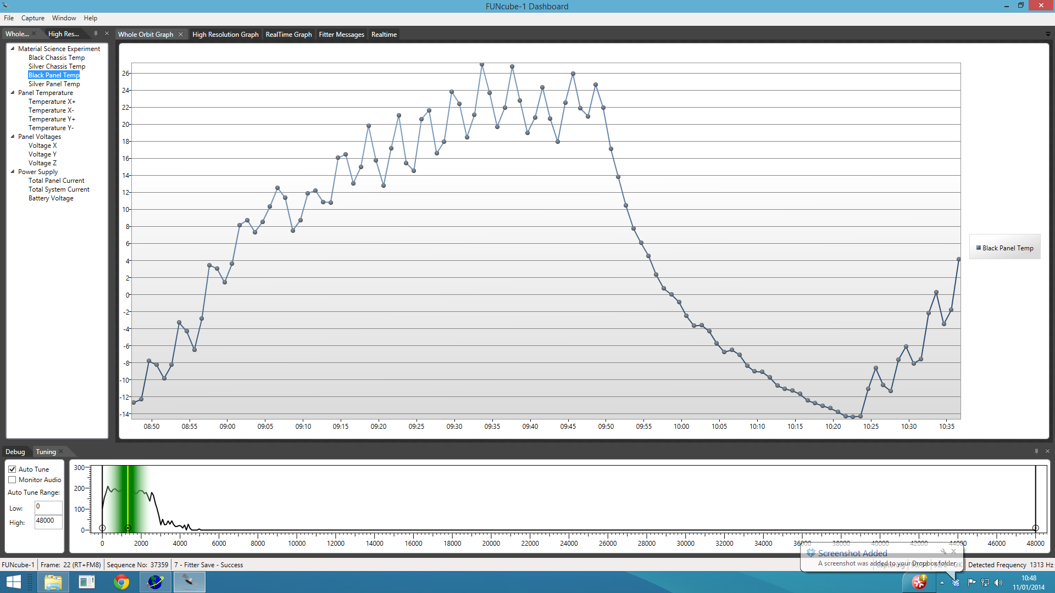
The Dashboard
Notes:
The Black strip looses energy quicker than the silver one

Slide 19
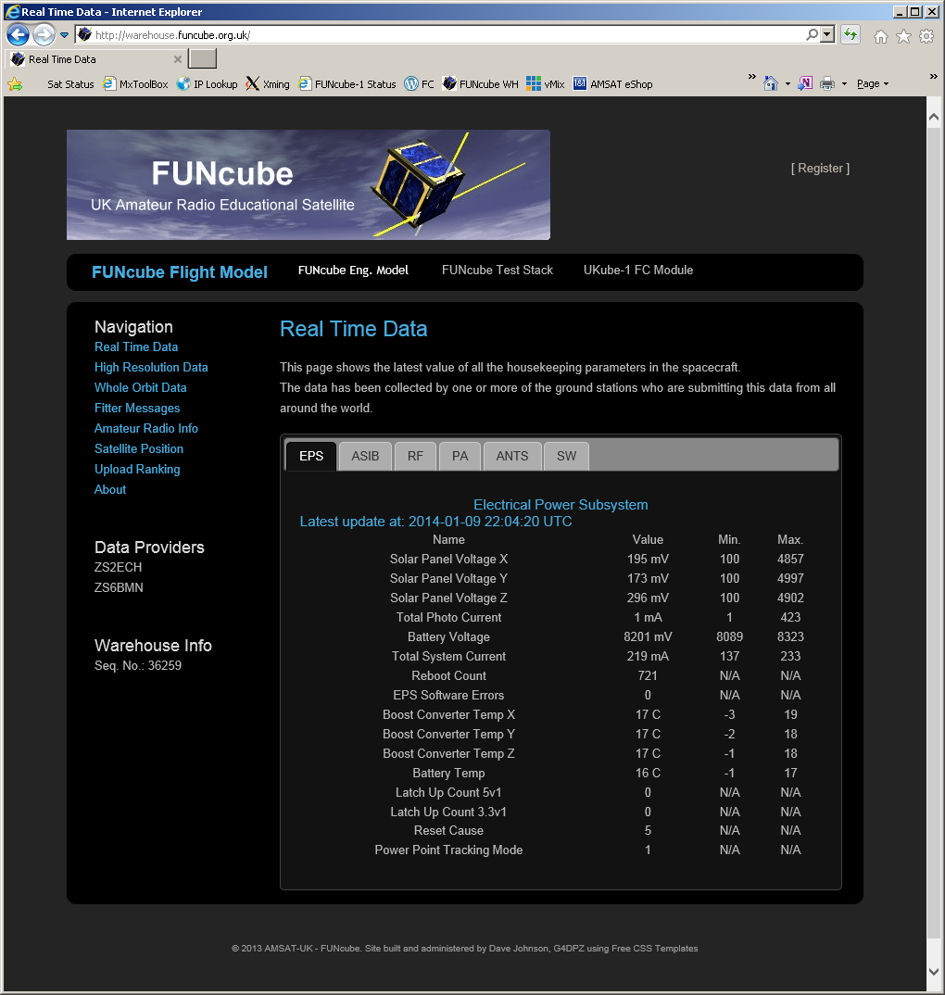
The Data Warehouse
An internet based database that records the telemetry collected from >450 users around the world.
Organises the data and makes it available for download
http://warehouse.funcube.org.uk
Notes:
More than 500 listeners around the world contribute data to the Warehouse

Slide 20
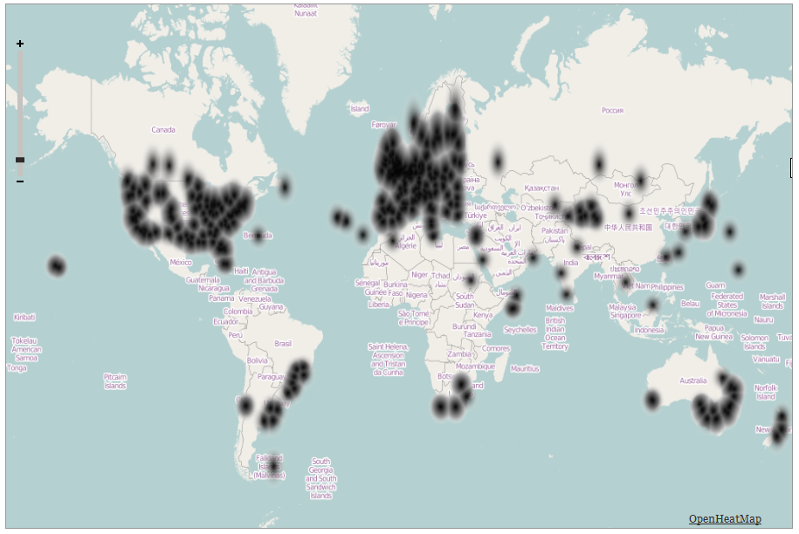
The Data Warehouse
Notes:
More than 600 listeners around the world contribute data to the Warehouse – we could really really do with some stations in the arctic/antarctic ..also on any of the islands in the South Atlantic, Indian and Pacific oceans...we would be pleased to sponsor some

Slide 21
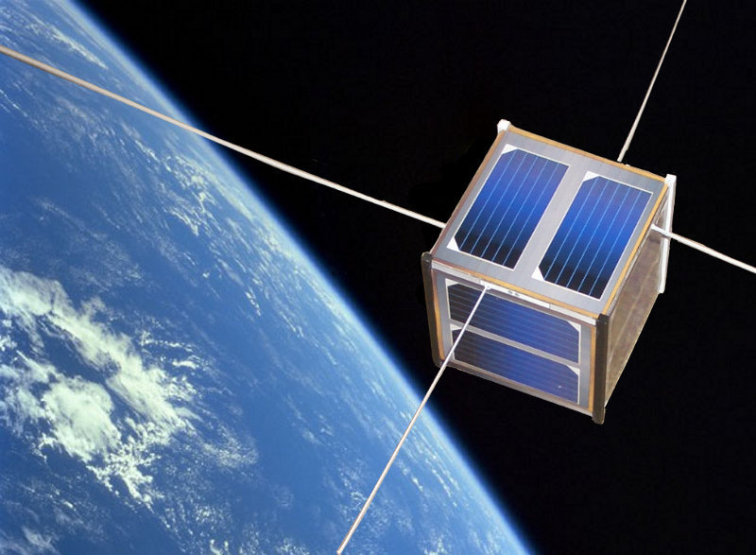
Using FUNcube data in the classroom

Slide 22
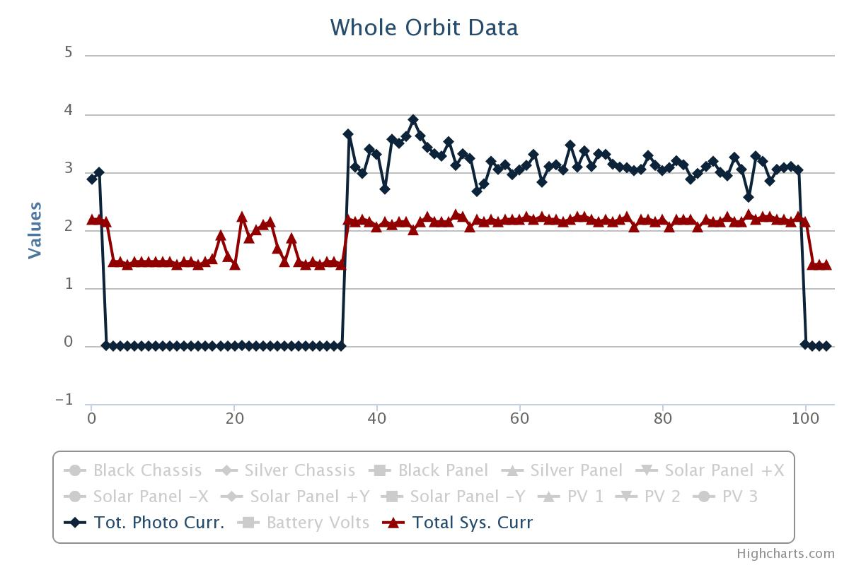
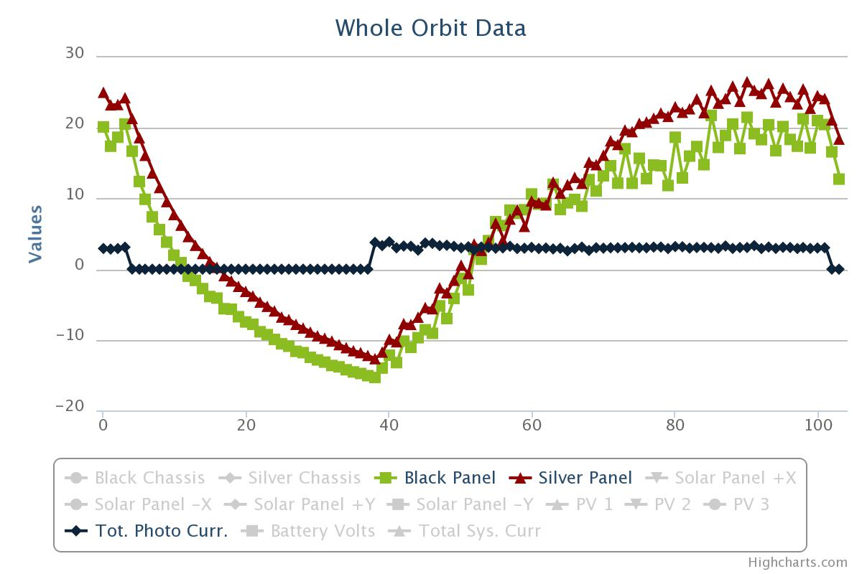
Using FUNcube data in the classroom
Conduction / radiation
+ specific heat capacity
Solar power
Voltage current and energy

Slide 23
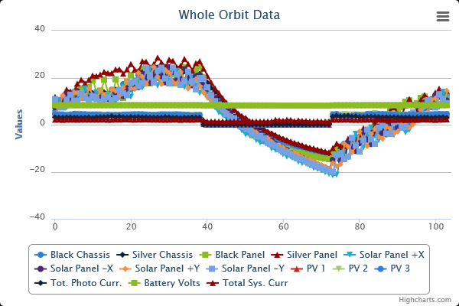
Real data from Space!

Slide 24
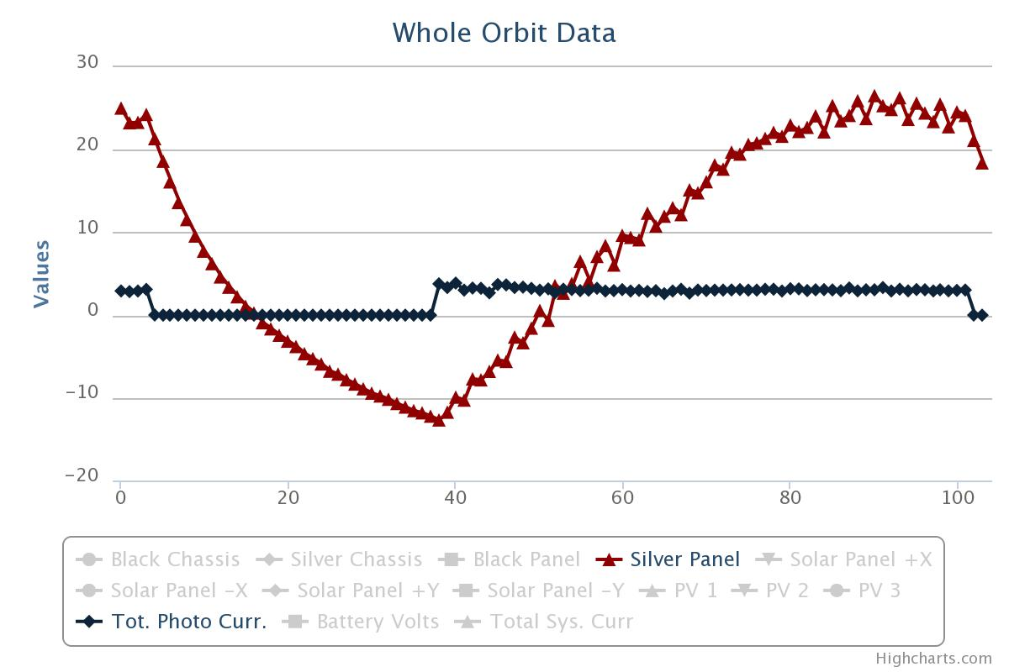
Using FUNcube data in the classroom
Velocity:
Eclipse time
Time in sun
Orbital period
External temperature

Slide 25
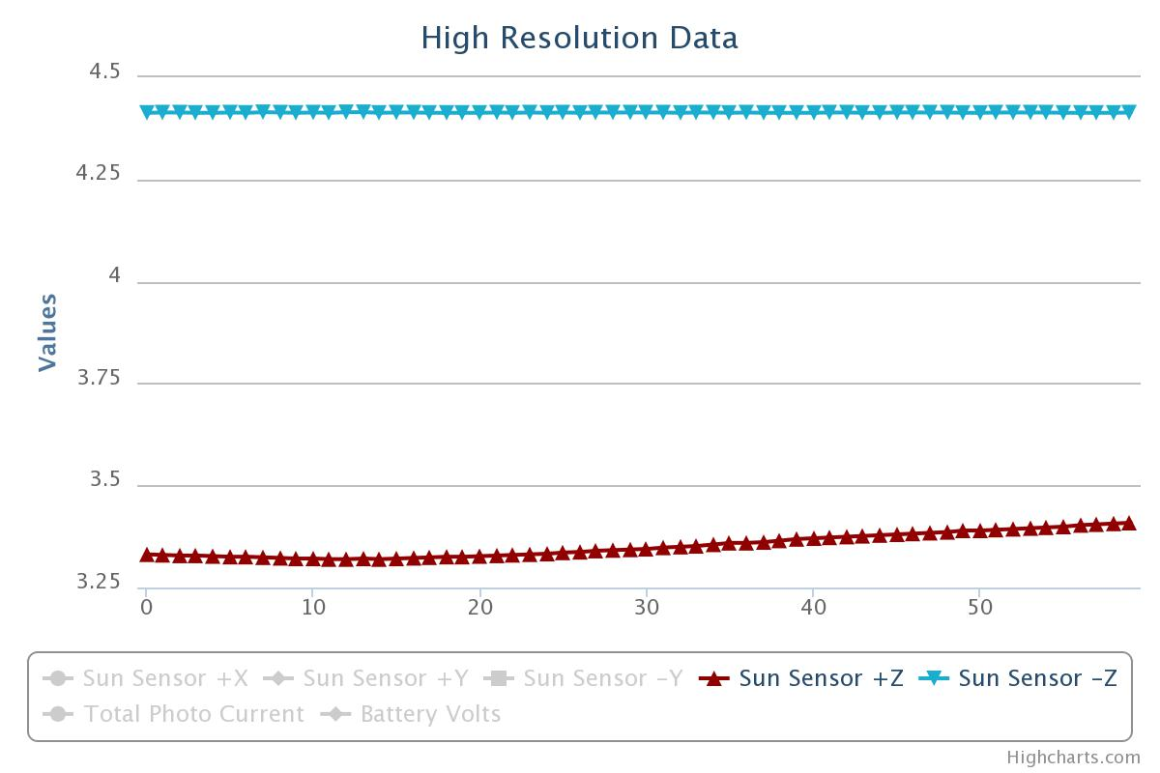
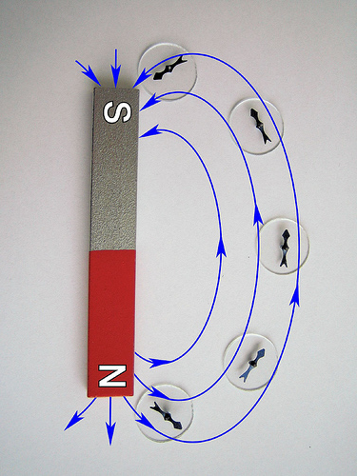
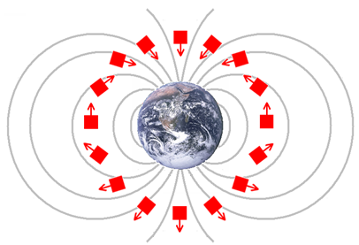
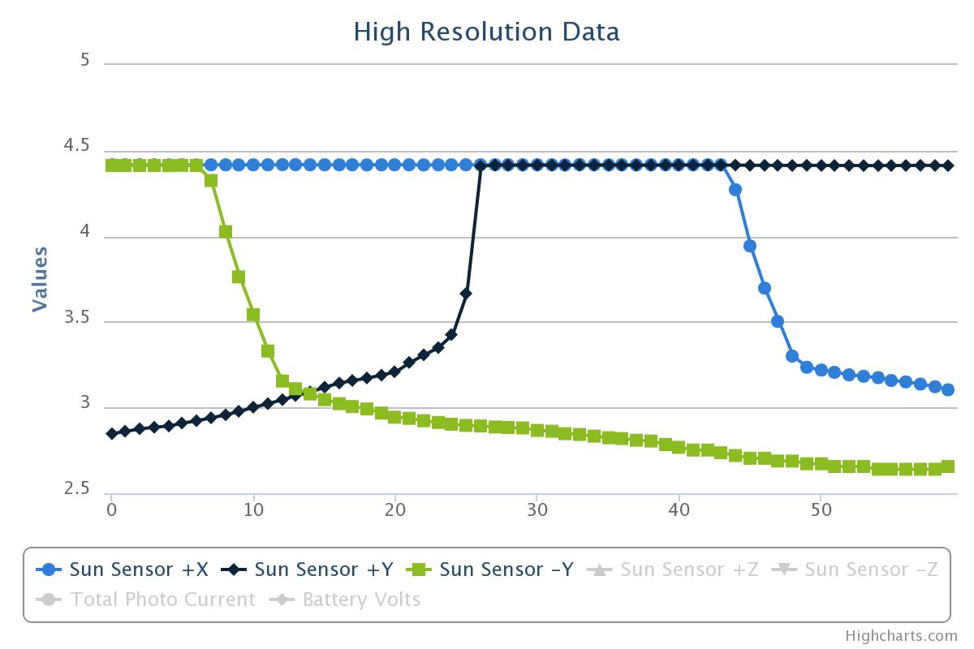
Using FUNcube data in the classroom
Magnetic fields

Slide 26
Using FUNcube-1 in the classroom
Using OCR Physics Curriculum for Key Stage 4 as an example.
Not limited to just Physics but can be developed into Mathematics, English, and other subjects, even History.

Slide 27
GCSE Key Stage 4 Physics – Key Areas
Orbits
  What is an orbit?
  How do you get into orbit? http://galileo.phys.virginia.edu/classes/109N/more_stuff/Applets/newt/newtmtn.html or http://galileoandeinstein.physics.virginia.edu/more_stuff/flashlets/NewtMtn/NewtMtn.html
  Use of low earth orbits
  Use of Geosynchronous orbits
  Which orbit is appropriate for communications, earth observation etc
  http://galileoandeinstein.physics.virginia.edu/more_stuff/flashlets/
Satellites
  “Object that orbits a much larger object”
  Earth has one natural satellite, the moon
  Earth has thousands of artificial satellites, including FUNcube-1

Slide 28
GCSE Key Stage 4 Physics – Key Areas
ElectroMagnetic Spectrum
  What is it?
  What does it include?
  How is light related to the EMS
  Where is radio included within the EMS
  What are the different uses of the EMS (e.g. medical/physical investigations, mobile phones, wifi, TV, commercial radio etc)
Communications
  Can take many forms
  Historically, Analogue communications methods predominated
  Today, digital communications methods
  What are the differences?
  Howdoes the ionosphere affect communications?

Slide 29
GCSE Key Stage 4 Physics – Key Areas
Alternative Energy Sources
  What are they?
  Where does a satellite get its energy from?
  How do you recharge the batteries whilst in space?
  Solar cells – is it a workable/long term renewable energy source?
  How can you monitor the energy produced by a solar cell in space?
Energy Transfer
  Conduction/radiation modes of energy transfer and what are the differences?
  How can you identify which mode is dominant in a particular circumstance?
  How do different coloured surfaces react when exposed to a heat source?
  How do different coloured surfaces radiate heat?
  How does heat radiation differ on earth and in space (Leslie’s Cube experiment)
  What are the sources of heat in space?

Slide 30
What about other subjects?
Mathematics
  Estimating speed from the telemetry?
  Calculating Doppler corrections
  Recognising patterns in data
  Deriving data for further analysis
History
  The launch vehicle was originally an ICBM with nuclear warheads
  SALT/SALT2 Talks
  Establishment of new business areas out of the end of the Cold War.
Geography
  Footprint/coverage/location

Slide 31
Using FUNcube data in the classroom
From OCR Key stage 4 Physics
Define Satellite
Orbits – Velocity and Altitude. – Newton’s cannon
Orbit types and uses - Polar (Earth observation) and geostationary (telecom)
Renewable energy. – Solar power
Energy transfers. Conduction and radiation
Specific heat capacity / The space environment and temperature
Doppler. – Typically AS, but red shift in KS4. Expanding universe.
Voltage / current / power / energy
Electro-magnetic spectrum (VHF communications)
Analogue and digital. – FUNcube communicates using just 300mW of digital data
Magnetic fields. Uses magnetic attitude control

Slide 32
Using FUNcube data in the classroom
Velocity:
Use graph from Whole Orbit Data to measure time of one orbit
Then calculate velocity by using Earth radius 6371km and satellite altitude (630km)
Given: Earth radius 6371km Satellite altitude 630km
From graph: Orbital period 98 minutes
Orbital radius = 6371 + 630 = 7001km
Orbit circumference 2 x Pi x radius. = 2 x 3.142 x 7001 = 43,988km
Velocity = 43,988 / 98 = 488.9 km/minute
or Velocity = 488.9 / 60 = 7.48 km / sec

Slide 33
Using FUNcube data in the classroom
Salters Physics
  Solar Cells/power generation
  Solar radiation levels
  Thermal Stress on electrical circuits
  Speed of light
  Radar - ranging
  Doppler Effect
  The electromagnetic spectrum
  Communications
  Space debris
  Space politics

Slide 34
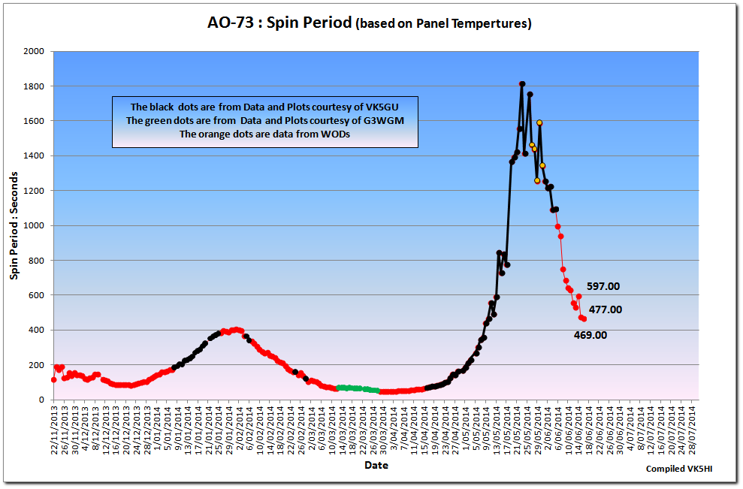
Notes:
A real unknown – why is our spin rate changing every day?

Slide 35
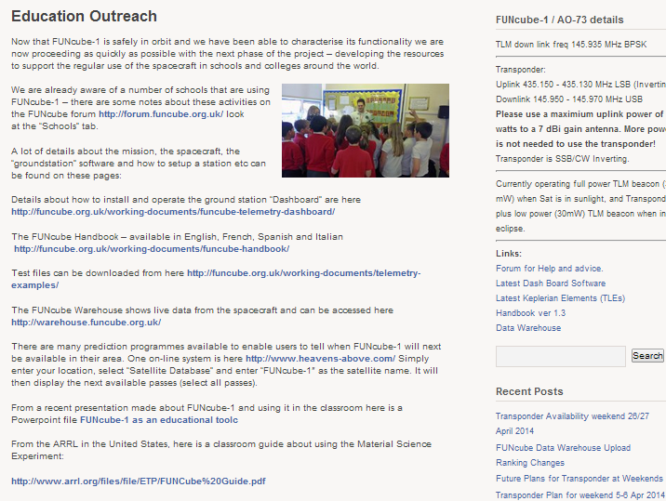
RESOURCES FOR the classroom
Notes:
Our website has a special section with educational outreach resources.....we are very grateful for all the contributions that we have received...especially the ARRL contribution!

Slide 36
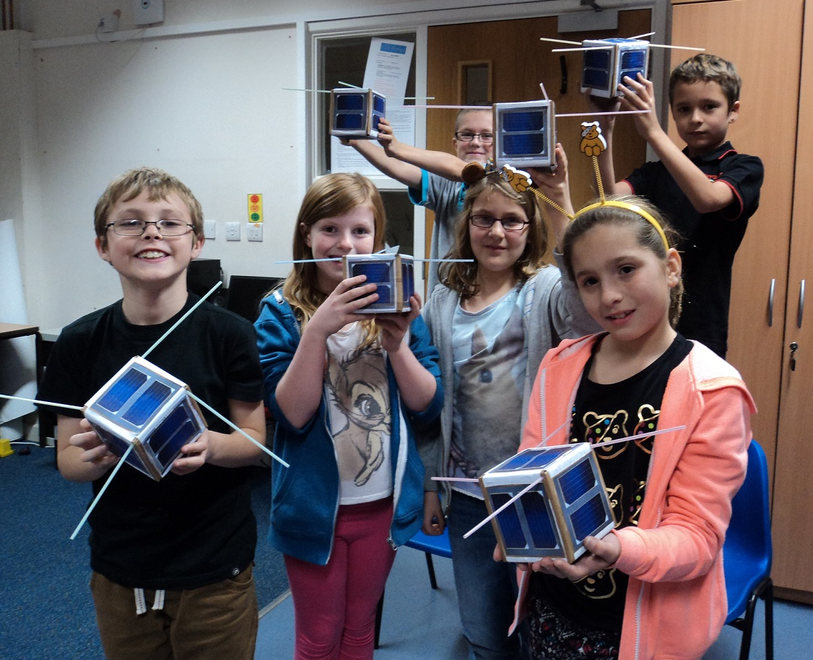
Follow-on Missions
FUNcube-2 on UKube launch 8th July 2014
FUNcube-3 on QB50p1 launch 19th June 2014
FUNcube-4 on ESEO launch late 2015
http://www.ubatubasat.com/

Slide 37
